Slide 1
Module 5: Adding Multiple Sources to a Dimension
Analytics: Server Architect (Siebel 7.7)
Notes:
Time: Lecture: approximately 35 minutes; labs: see Lab Guide for timings.
Intent: Discusses how to add information to a logical table from multiple physical sources by modeling multiple logical table sources for a logical table, where data is duplicated in the multiple physical sources, and how to configure the most economical source.
Flow: Introduces concepts then describes implementation steps in the context of an ABC example.
Key Terms:
Normalized table structures
Denormalized table structures
Multiple sources
5

Slide 2

Module Objectives
After completing this module you will be able to:
  Describe normalized and denormalized table structures in database designs
  Add multiple sources to an existing logical table source for a dimension in the business model
  Add a second table source to a dimension in the business model
Why you need to know:
  Source data that you want to model is often stored in multiple tables and may not be in an ideal structure
Notes:
Each objective and “why you need to know” should be stated aloud.

Slide 3
Table Structures
Normalized table structures:
  Consist of many tables—data has been split apart, or normalized
  Reduce data redundancy to improve performance
  Do not work well for queries that perform business data analysis
Denormalized table structures:
  Follow a business model and are easier to understand
  Have data that may appear in several locations in the database
    Reduces the need for join paths
  Can take the form of a star schema
Notes:
Normalized schemas are used in many online transaction processing (OLTP) systems. They have many tables (hundreds or even thousands) because the data has been carefully taken apart—normalized, in database terminology—with the primary goal of reducing data redundancy and bringing about fast update performance. These schemas generally do not work well for queries that perform historical analysis due to two major problems: poor performance and difficulty in posing the question in SQL.
A dimensional schema (covered in the overview module) is a denormalized schema that follows a business model. This structure contains dimension tables, which contain attributes of the business, and fact tables, which contain individual records with a few facts and foreign keys to each of the dimension tables. Dimensional schemas are very good for business analysis and have two major advantages: they have better query performance and are easier to understand.
5

Slide 4
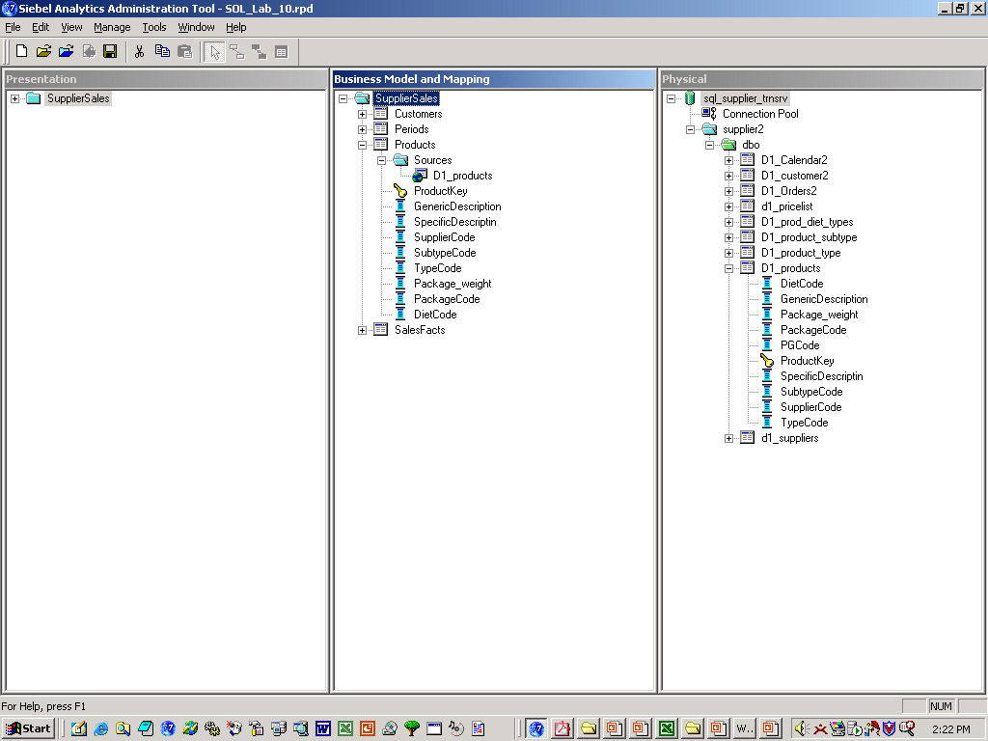
Business Challenge
Data may be spread among several physical tables and needs to be combined into a single logical table
  Some data may be normalized; some data may be duplicated
These normalized tables contain additional product information and are joined to D1_products
Notes:
This slide presents the business challenge: adding information to a dimension table when the additional information is stored in physical tables with a normalized table structure. Many database administrators consider normalized table structures good database design, so this is common.
Up to this point in the ABC repository, the Product logical table source is mapped to the root product table, D1_products. The physical tables that store additional product information are normalized. The additional product information is stored in multiple detailed tables that snowflake off the root table, D1_products.
Also, the product information stored in the normalized tables is duplicated in some of the detailed tables. You will need to configure mapping for the most economical source (covered in more detail later in the module).

Slide 5
Business Solution
Model multiple physical sources for the logical table
  Where data is not duplicated across tables
    Add physical tables to an existing logical table source
  Where data is duplicated across tables
    Add a second logical table source that maps to the physical table that is the most economical source
Notes:
This presents the business solution, modeling multiple physical sources for a dimension table by adding physical tables (that have been imported into the Physical layer) to the existing logical table source. Where data is duplicated in the physical sources, add a second logical table source in order to configure the most economical source.
5

Slide 6
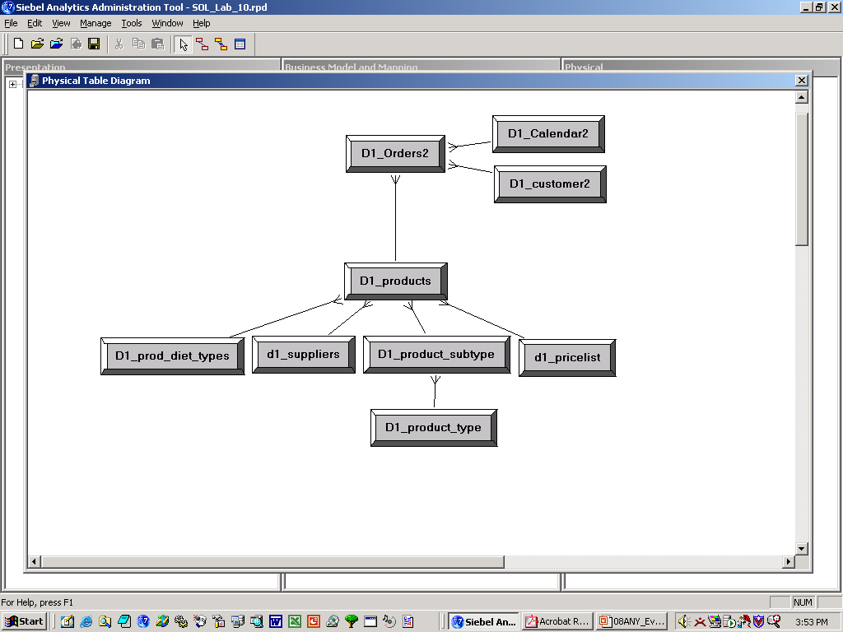
ABC Example
Add normalized tables that store price list, type description, and supplier information to the Product dimension in the SupplierSales business model
The additional product information is contained in separate tables and joined to the root table, D1_products
Notes:
In the ABC example, all product information is stored in multiple physical tables that are normalized. D1_products is the root table and additional product information is stored in multiple detailed tables that snowflake off the root table. Up to this point in the ABC example, the columns in the Product logical table are stored in the root product table, D1_products. Now you want to include additional information from the other product tables that snowflake off the root table.

Slide 7
Implementation Steps
Import physical sources and create supporting joins (as usual)
Determine the physical columns
Drag columns onto existing source
  Automatically adds the physical table sources, joins, and column mappings
Specify the most economical source
Rename the columns (as usual)
Add columns to presentation catalog (as usual)
Notes:
This is a structuring slide listing the implementation steps. A slide for the fourth bullet (specify most economical source) will list another subset of steps for implementing.
5

Slide 8
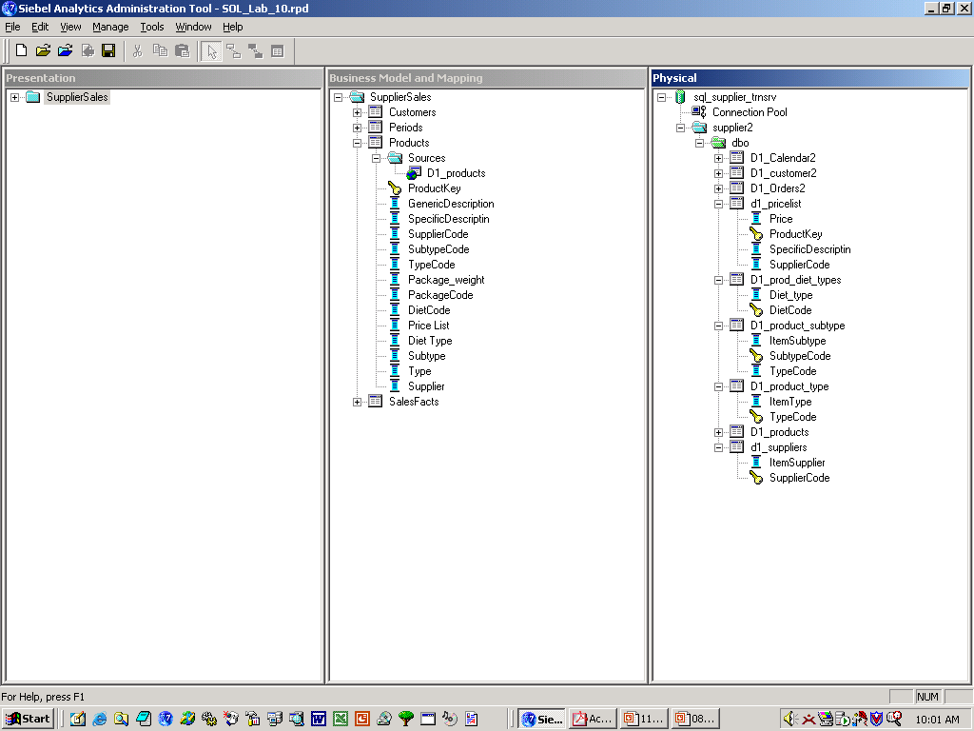
Determine the Physical Columns
Locate the tables and columns in the Physical layer with the additional product information
These physical columns contain the additional product information
Notes:
Once you have imported the table schemas into the Physical layer (and if necessary, configured join relationships), locate the tables and columns that store the additional product information that you want to add to the Product logical table.

Slide 9
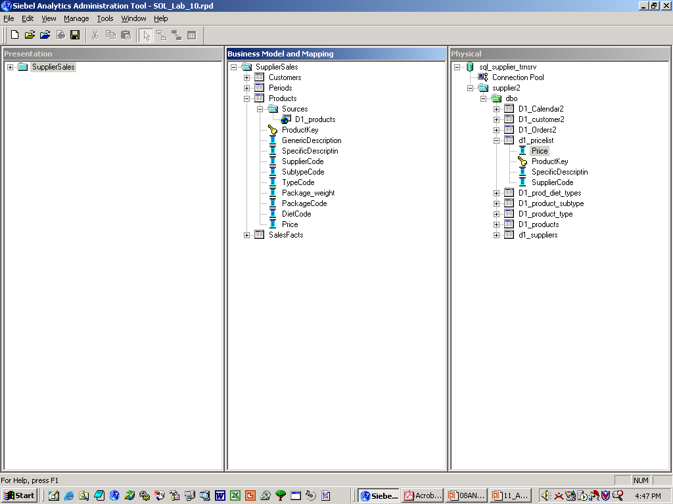
Drag Columns onto Existing Source
Drag each physical column onto the existing logical table source for the Product dimension
This Price physical column is dragged onto the D1_products Sources …
… to add the price list information to the Products dimension
Notes:
To add the additional product information to the Product logical table, drag each column onto the existing logical table source.
5

Slide 10
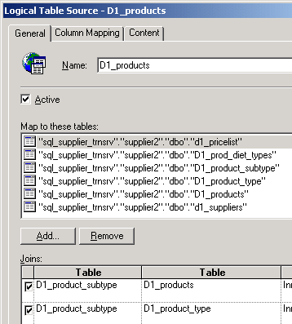
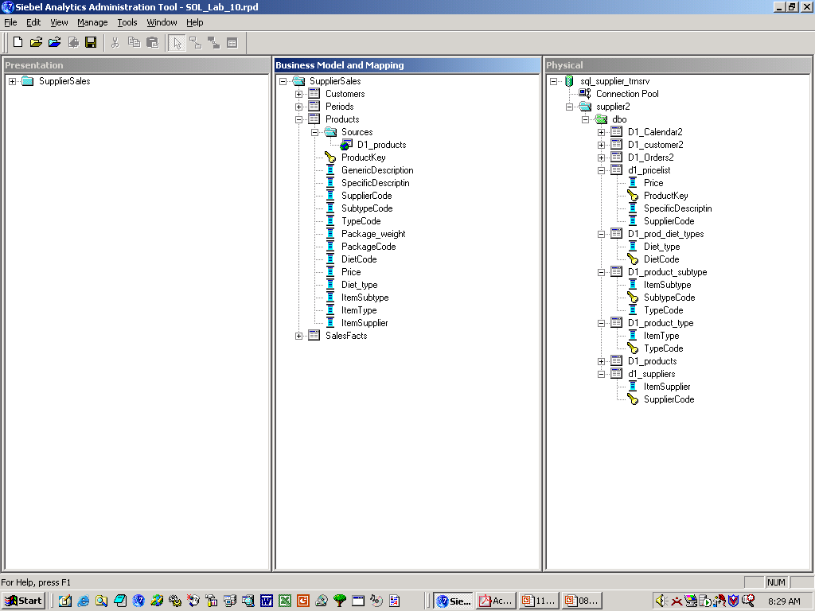
Drag Columns onto Existing Source Continued
Creates the mapping, joins, and new columns in the Products dimension automatically
Single source maps to multiple physical tables
New logical columns are added to the Products dimension
Joins automatically created
Notes:
Dragging the columns onto the existing logical table source automatically adds:
Columns to the logical table
Mappings between the existing source and the new physical sources
Joins between the logical and physical tables

Slide 11
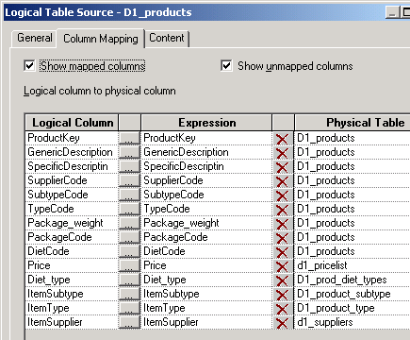
Drag Columns onto Existing Source Continued
Maps the new logical columns to the physical tables automatically
Notes:
In addition, dragging columns onto the existing logical table source automatically maps the new columns to the physical tables.
5

Slide 12
Alternative Method to Add Sources to an Existing Source
Use source properties box to select physical tables
  Create the table mappings and joins
Add logical columns manually
Create logical column mappings manually
Notes:
There is a manual process for mapping multiple sources that is not covered in this module. However, students will experience this in the lab.

Slide 13
Specify Most Economical Source
Where data is duplicated in the physical sources, determine the most efficient column mapping to physical sources
  For each logical column in a query, the Siebel Analytics Server uses the column mapping to determine the physical columns to query
Notes:
As stated earlier, some product information is duplicated in the detailed tables. You want to configure the most economical source, because the way you configure logical table sources is an important determinant of the queries that the Siebel Analytics Server creates. For every Logical column in a query, the Siebel Analytics Server examines the mappings that exist in logical table sources and uses the mappings to determine which Physical columns to query. You need to examine where the product data is duplicated in the Physical layer and configure mappings for the most economical source.
5

Slide 14
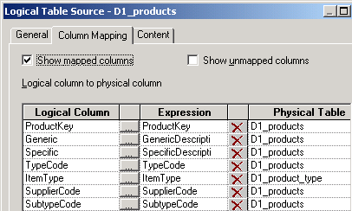
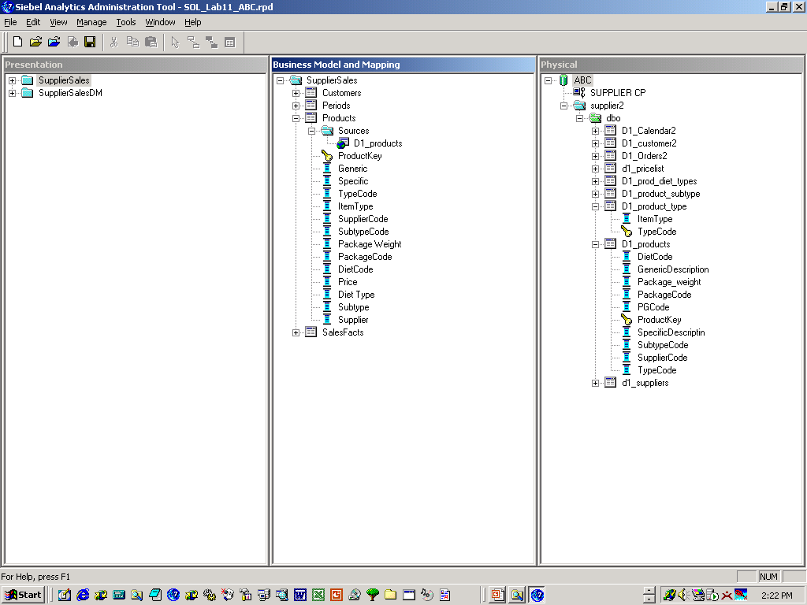
Example: Specify Most Economical Source
ItemType is a column that was just added to the Product logical table—it maps to a different physical table from the other logical columns
Current mapping for ItemType logical column
Notes:
In our ABC example, one of the new columns in the Product logical table, ItemType, was dragged from the D1_product_type table in the Physical layer. Therefore the mapping for this column is to D1_product_type. Notice that the TypeCode column maps to the root table, D1_products. The importance of this is discussed on the next slide.

Slide 15
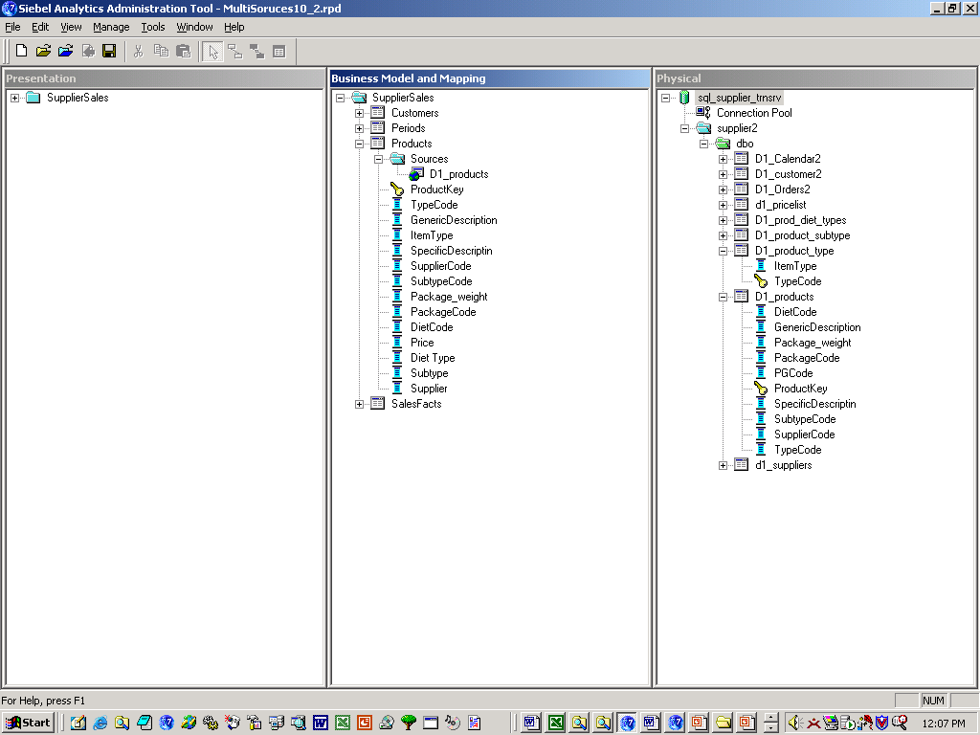
Example: Specify Most Economical Source Continued
A more economical source for ItemType is a table that stores information for other logical columns as well—the server queries only one table
Since D1_product_type stores TypeCode and ItemType information, it is a more economical source
Notes:
When examining the Physical layer, you will see that the physical table that ItemType maps to, D1_product_type, also stores information for TypeCode (which is currently mapped to the root table). Since D1_product_type stores information for both columns, it is a more economical source. A query for ItemType and TypeCode information only needs to access one table, D1_product_type.
5

Slide 16
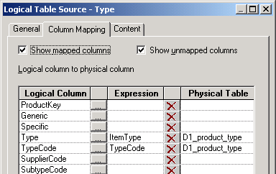
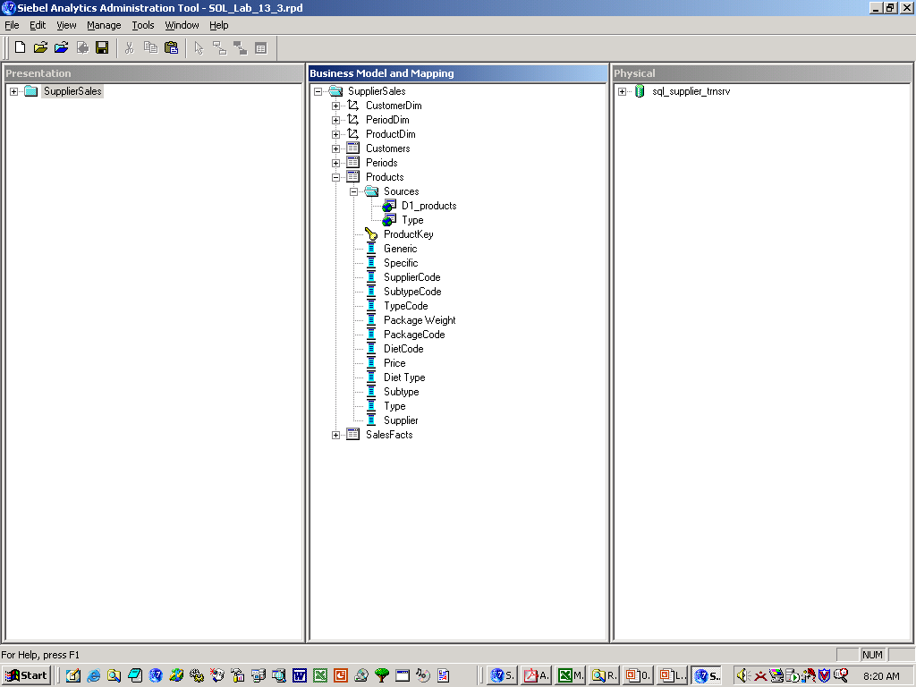

Example: Specify Most Economical Source Continued
Adding a second logical table source to the Product dimension enables you to map ItemType and TypeCode to the physical table that stores information for both columns
Allows creation of a new logical column
A second logical table source is added to Products
The two logical columns are now mapped to a more economical source—the server queries only one table for both columns
Notes:
To model this more economical source you need to add a second logical table source to the Products logical table and map the two columns to the D1_product_type physical table. Since the two logical columns are now mapped to a more economical source, the Analytics Server only queries one table for both columns.

Slide 17
Steps to Specify Most Economical Source
0/3
1. Create a new logical table source manually
2. Select the physical table
3. Specify the content
Notes:
This is a structuring slide for specifying the most economical source. Do not teach the steps or concepts here because subsequent slides cover them in detail.
5

Slide 18
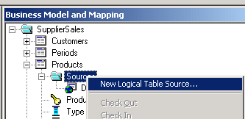
1. Create a New Logical Table Source Manually
1/3
Right-click the Sources folder for the Product dimension and select New Logical Table Source
Notes:
The first task is to create a new logical table source. This is done manually as described in the slide. Right-click the Sources folder and select New Logical Table Source.

Slide 19
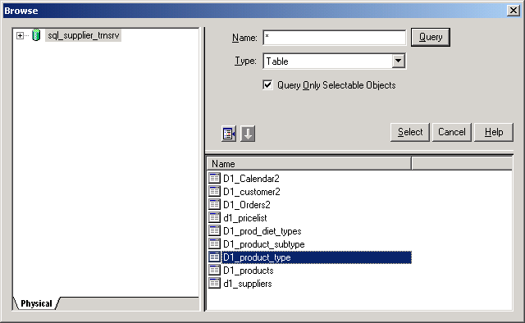
2. Select the Physical Table
2/3
Click the Add button and select the physical table
Notes:
The next step is to select the physical table to associate as a new logical table source with the logical table.
5

Slide 20

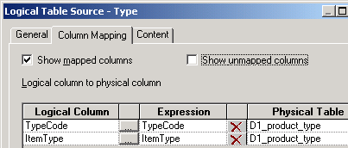
3. Specify the Content
3/3
The TypeCode logical column is now mapped to two physical tables
TypeCode maps to two physical tables
Notes:
Adding D1_product_type as a second logical table creates the condition where a single logical column, TypeCode, is mapped to two physical tables, the root table, D1_product and the detailed table, D1_product_type. You need to tell the Analytics Server that these sources contain different content by configuring a content filter (explained on the next slide). This is called specifying the content.

Slide 21
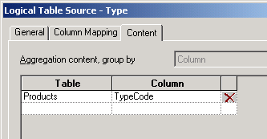
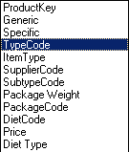
3. Specify the Content Continued
3/3
Multiple sources require content information
  Define the content for the TypeCode column on the Content tab of the second logical table source
    Lets Analytics Server know under what circumstance to use a particular source
Specify the content for the source so the Analytics server knows it contains different content and queries d1_products_type instead of D1_products for TypeCode
Notes:
On the Content tab of the Type logical table source (maps to D1_product_type), select the TypeCode column. This tells the Analytics Server which table to access for the TypeCode information.
5

Slide 22
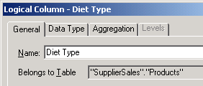
Rename the Columns
Create names for the new columns that users can recognize in the business model
Notes:
Create column names that users understand. See the student note regarding the Rename Wizard.

Slide 23
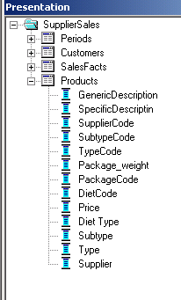
Add Columns to Presentation Catalog
Drag the new logical columns onto the Product presentation table to make them available to users
Notes:
To make the columns visible to end users, you must drag the logical columns into the Presentation layer. You drag the columns on top of the table in the presentation layer and the Administration Tool creates the appropriate column entries in the layer.
5

Slide 24
Summary
This module showed you how to:
  Describe normalized and denormalized table structures in database designs
  Add multiple sources to an existing logical table source for a dimension in the business model
  Add a second table source to a dimension in the business model
Notes:
Review Questions:
Question: How are normalized tables structured?
Answer: Normalized tables consist of many tables where that data has been split apart to reduce data redundancy and to improve performance.
Question: How are denormalized tables structured?
Answer: Denormalized table structures follow a business model, are easier to understand, can have data duplicated in the database, and can take the form of a Star schema.
Question: Which table structure works better for analytical queries, normalized or denormalized?
Answer: Denormalized.
Question: When you drag a physical column onto an existing logical table source, the column is added to the logical table and automatically mapped to its physical source. True or false?
Answer: True.

Slide 25
Lab
In the lab you will:
  Add multiple table sources to an existing logical table source of a dimension in the business model
  Add a second table source to a dimension in the business model
Notes:
Labs and Troubleshooting:
See Lab Guide for details.
Lab 5-1, step 4: Students are defining joins and foreign keys (using the Physical Tables Diagram view) for the detailed product tables they imported into the repository. A common error is to select the wrong icon for creating the join. Students should use the New Foreign Key icon (on the tool bar, it’s the icon on the left), not the Complex Join icon.
5

